Slide 1

NYC Vegetarian Restaurant
TripAdvisor Review
Jessie Gong

Slide 2
Web Scraping

Slide 3
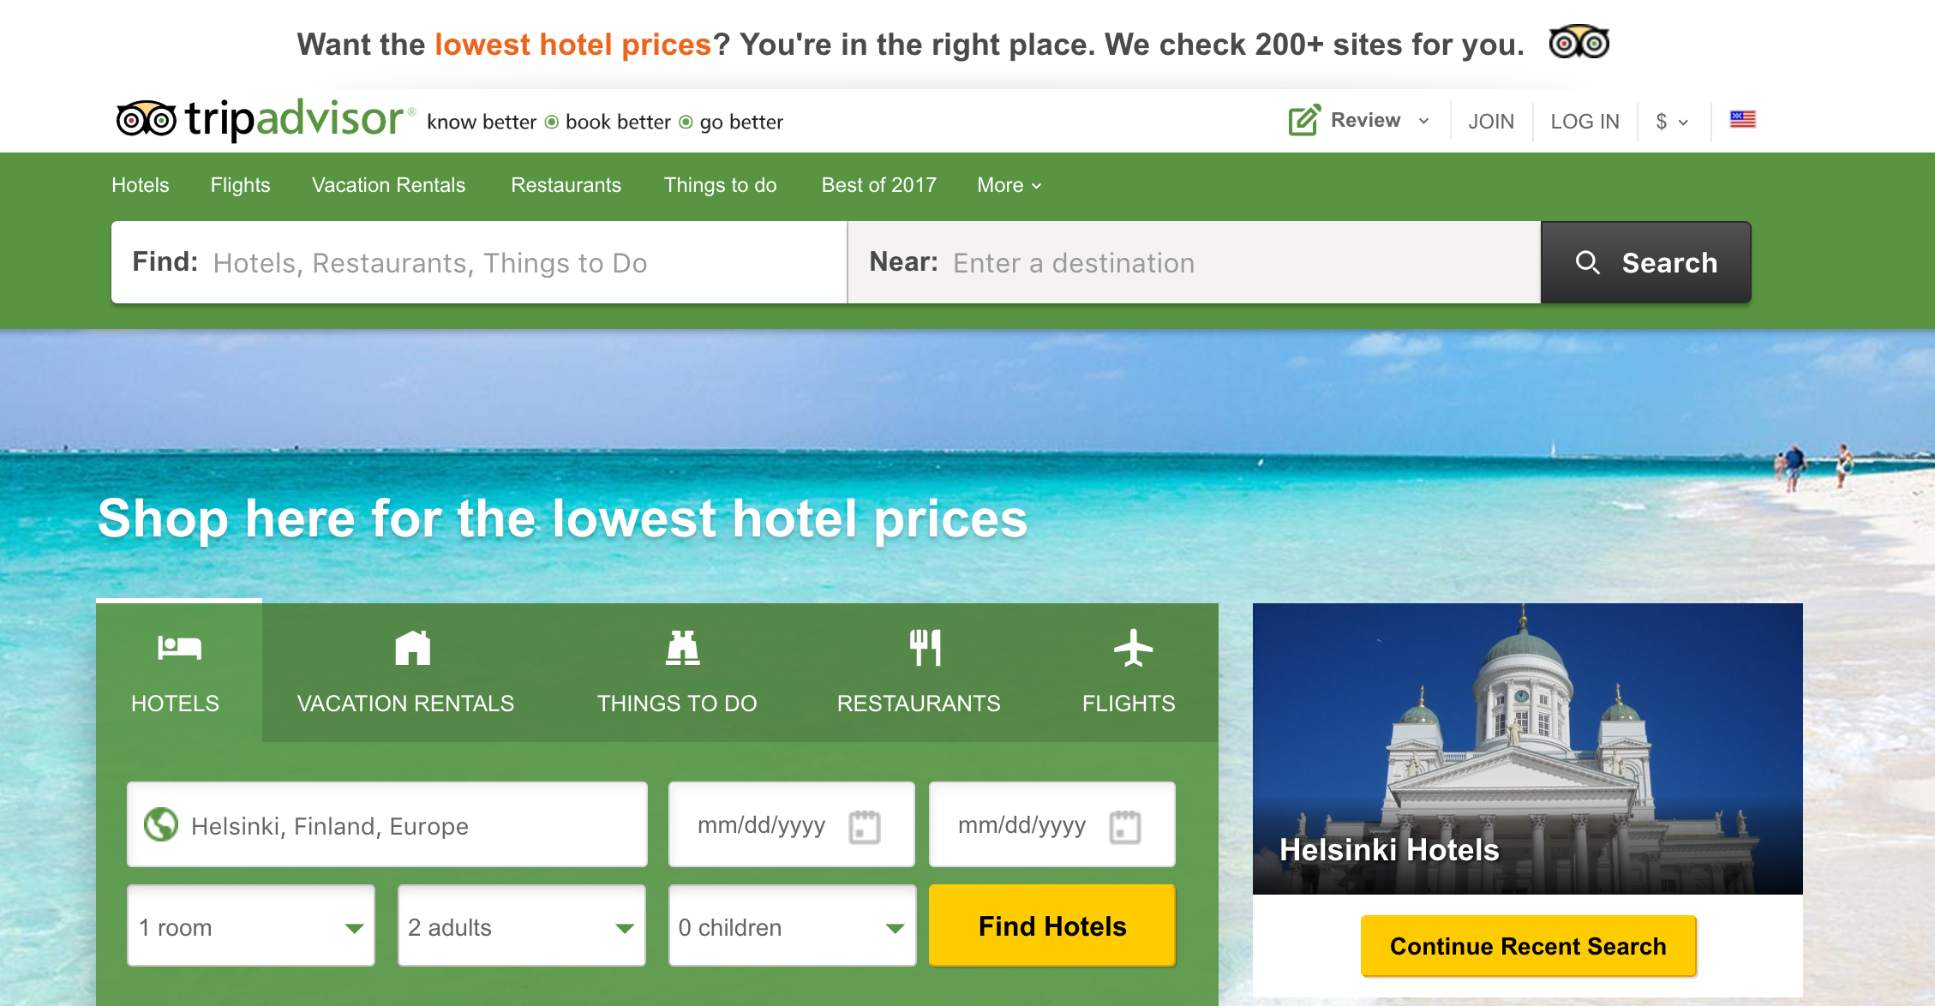
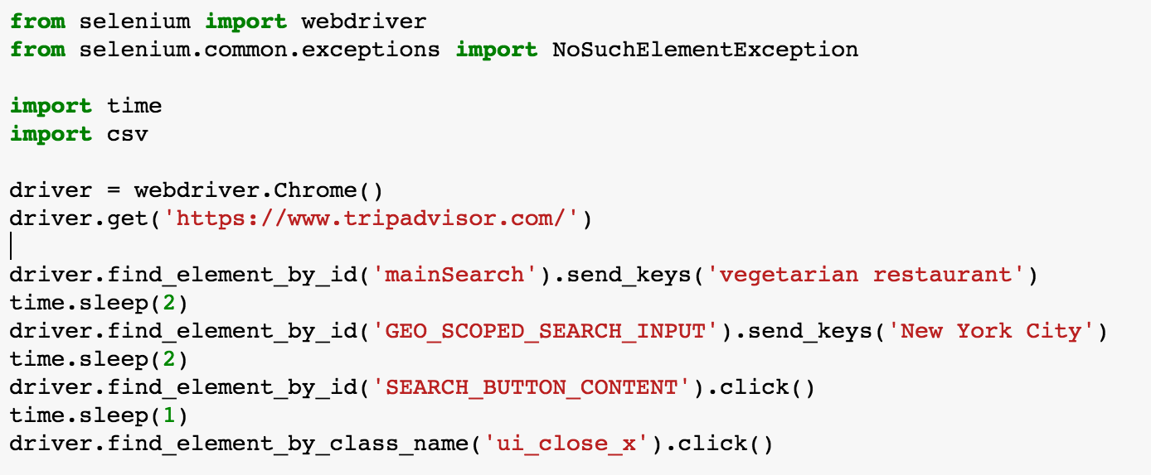
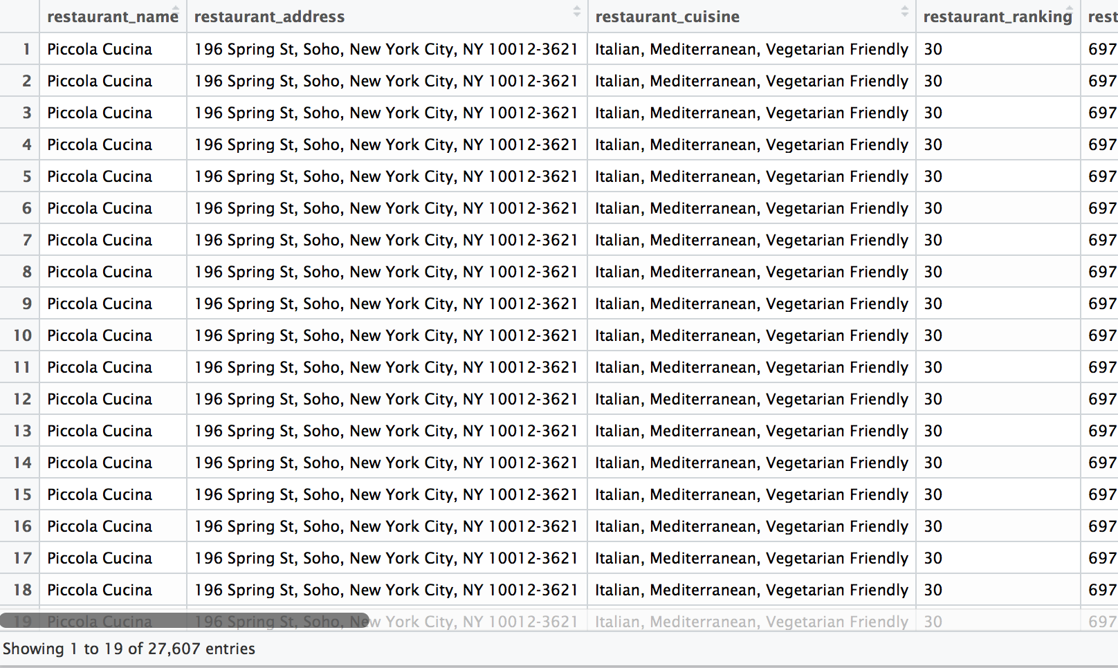
.CSV
356 restaurants
27607 reviews
1

Slide 4
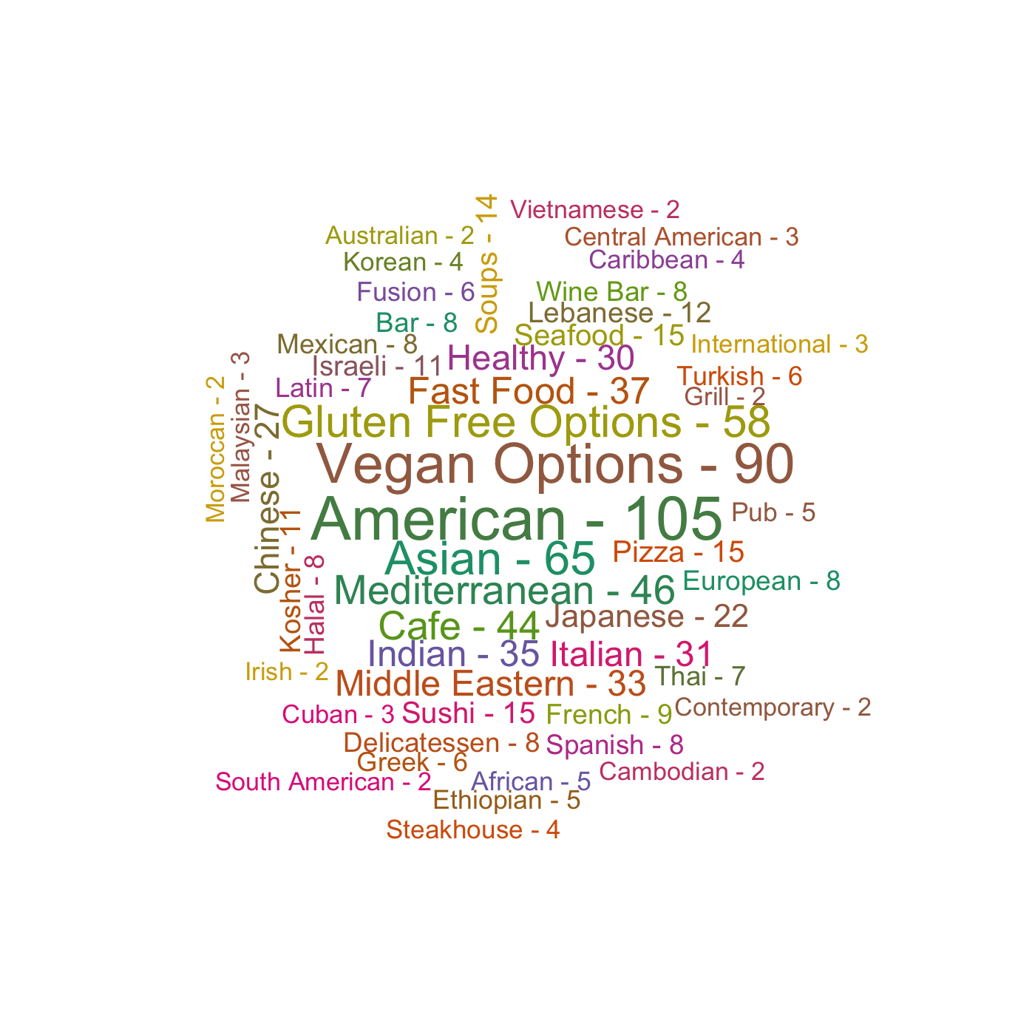
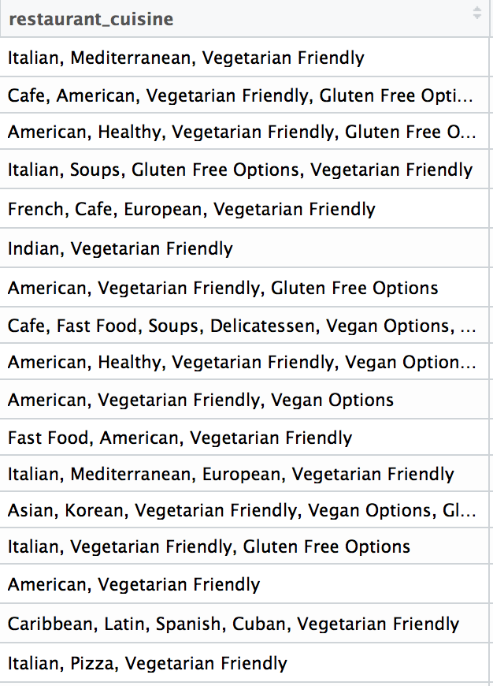
Cuisines

Slide 5
Tf-Idf

Slide 6
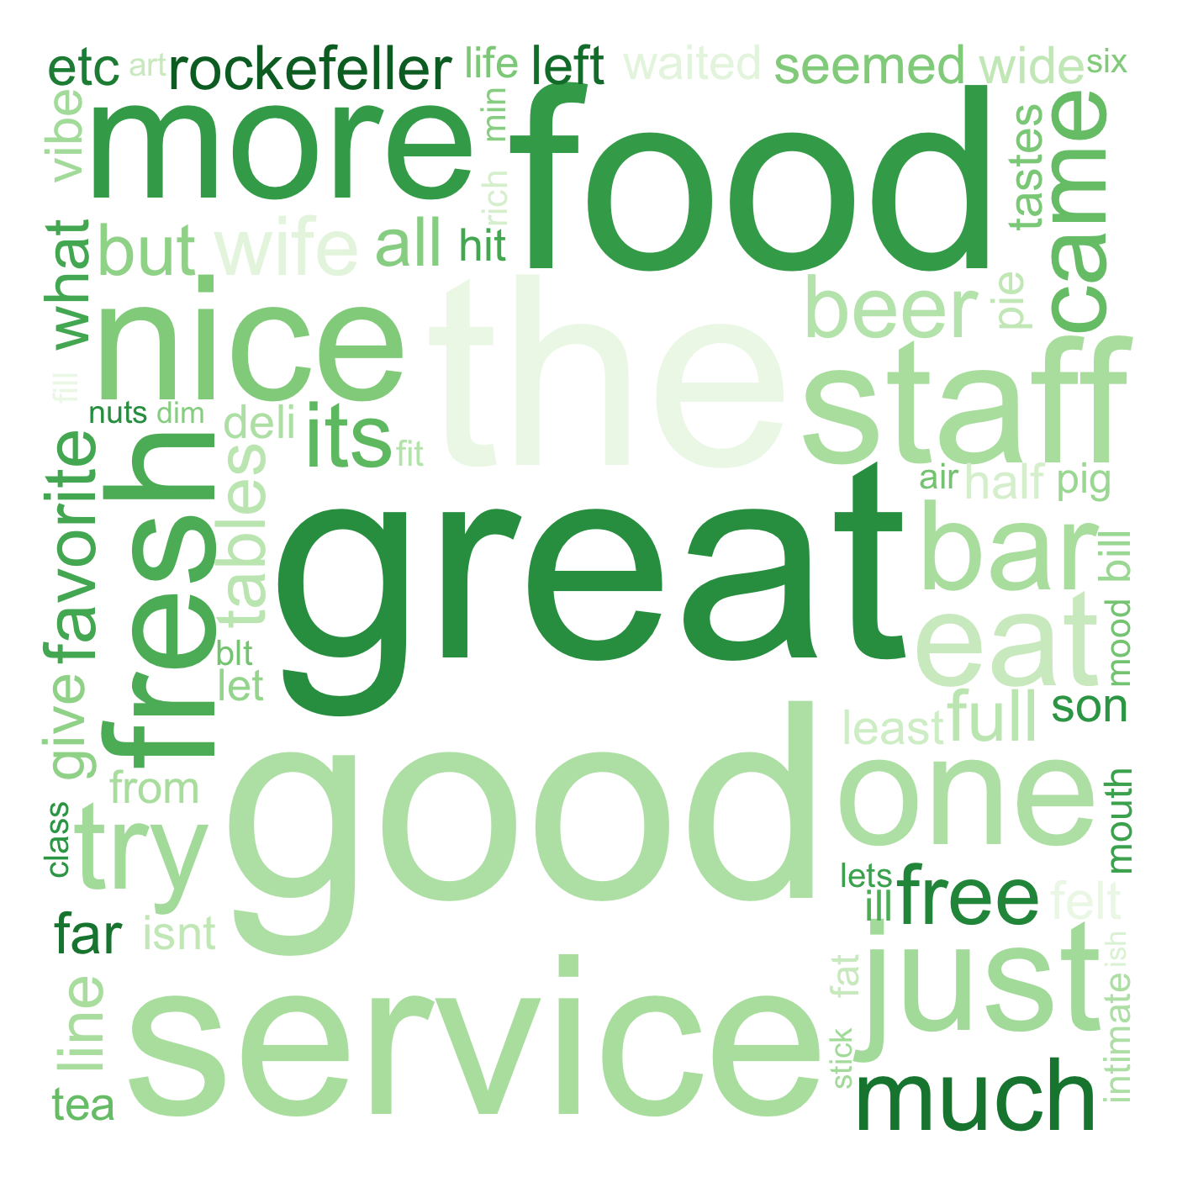
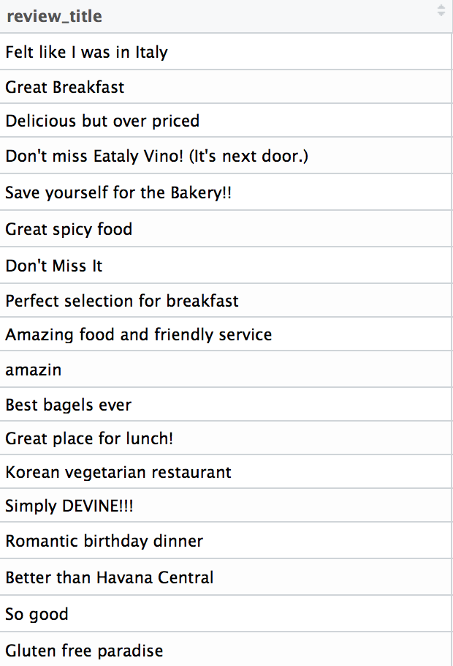
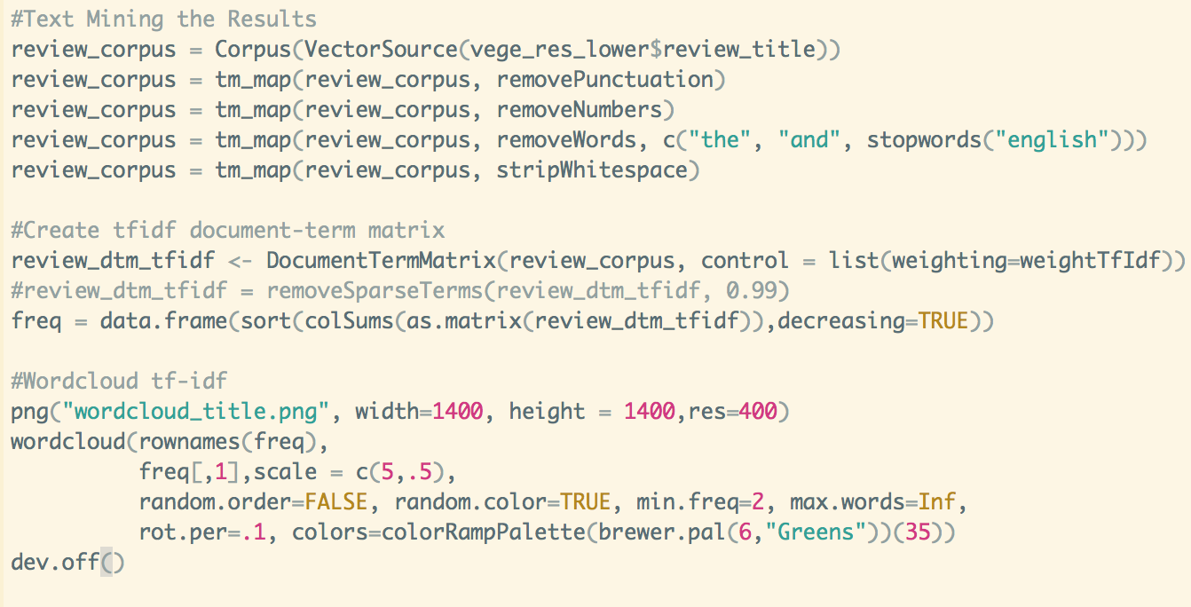
Tf (word): frequency the word appears in the current document
Df (word): frequency or number of documents the word appears in the corpus
N: number of documents
Tf_Idf (word) = Tf (word) * log (N / Df (word) )

Slide 7
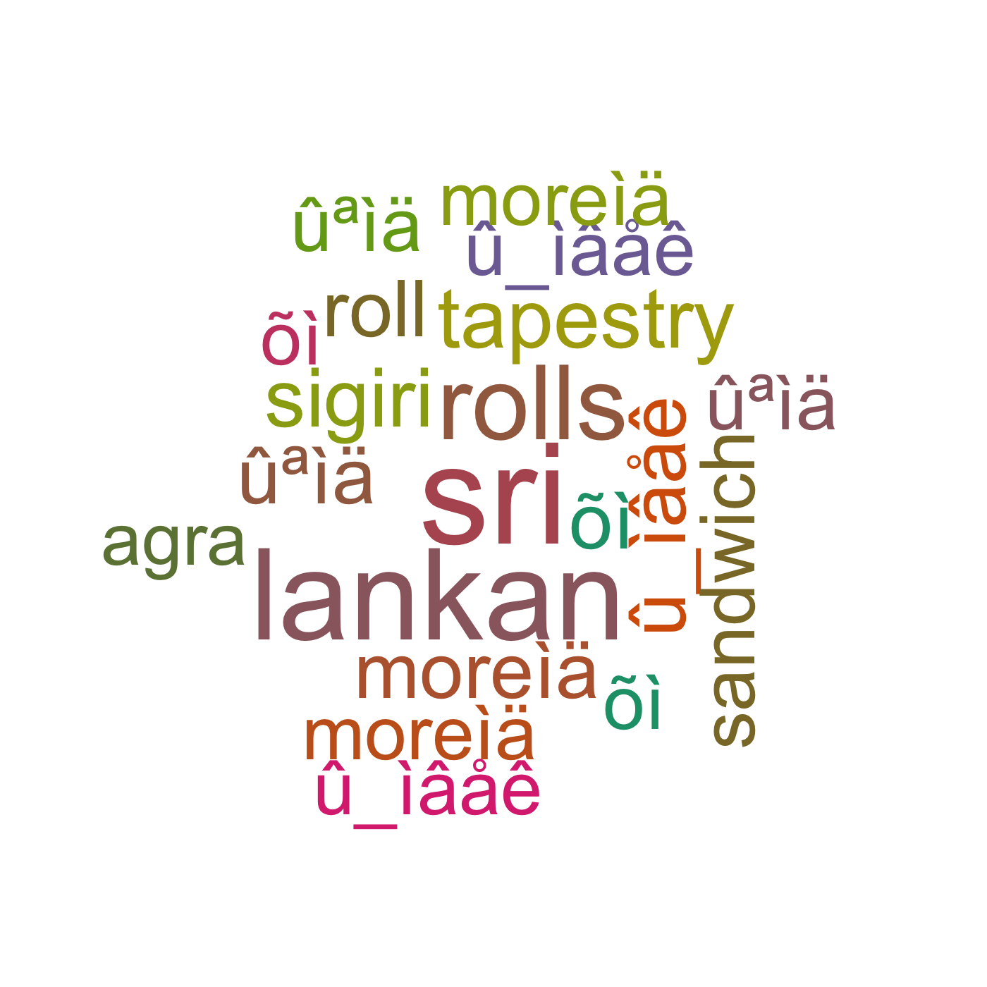
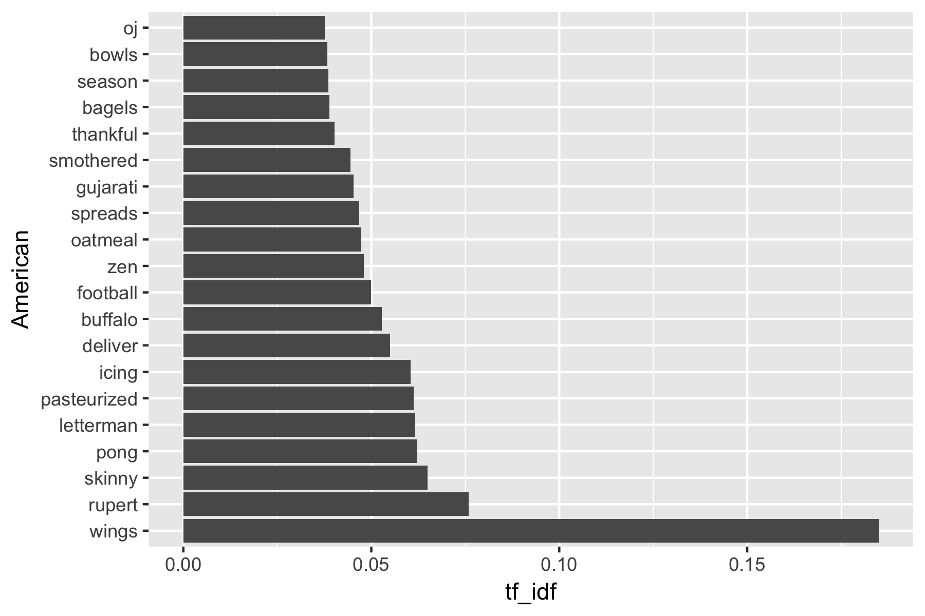
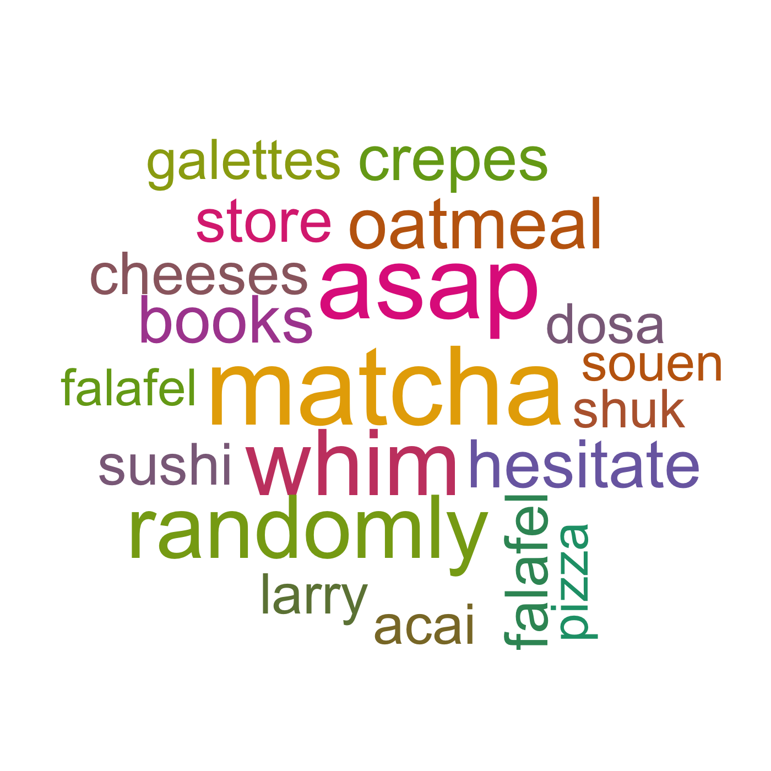
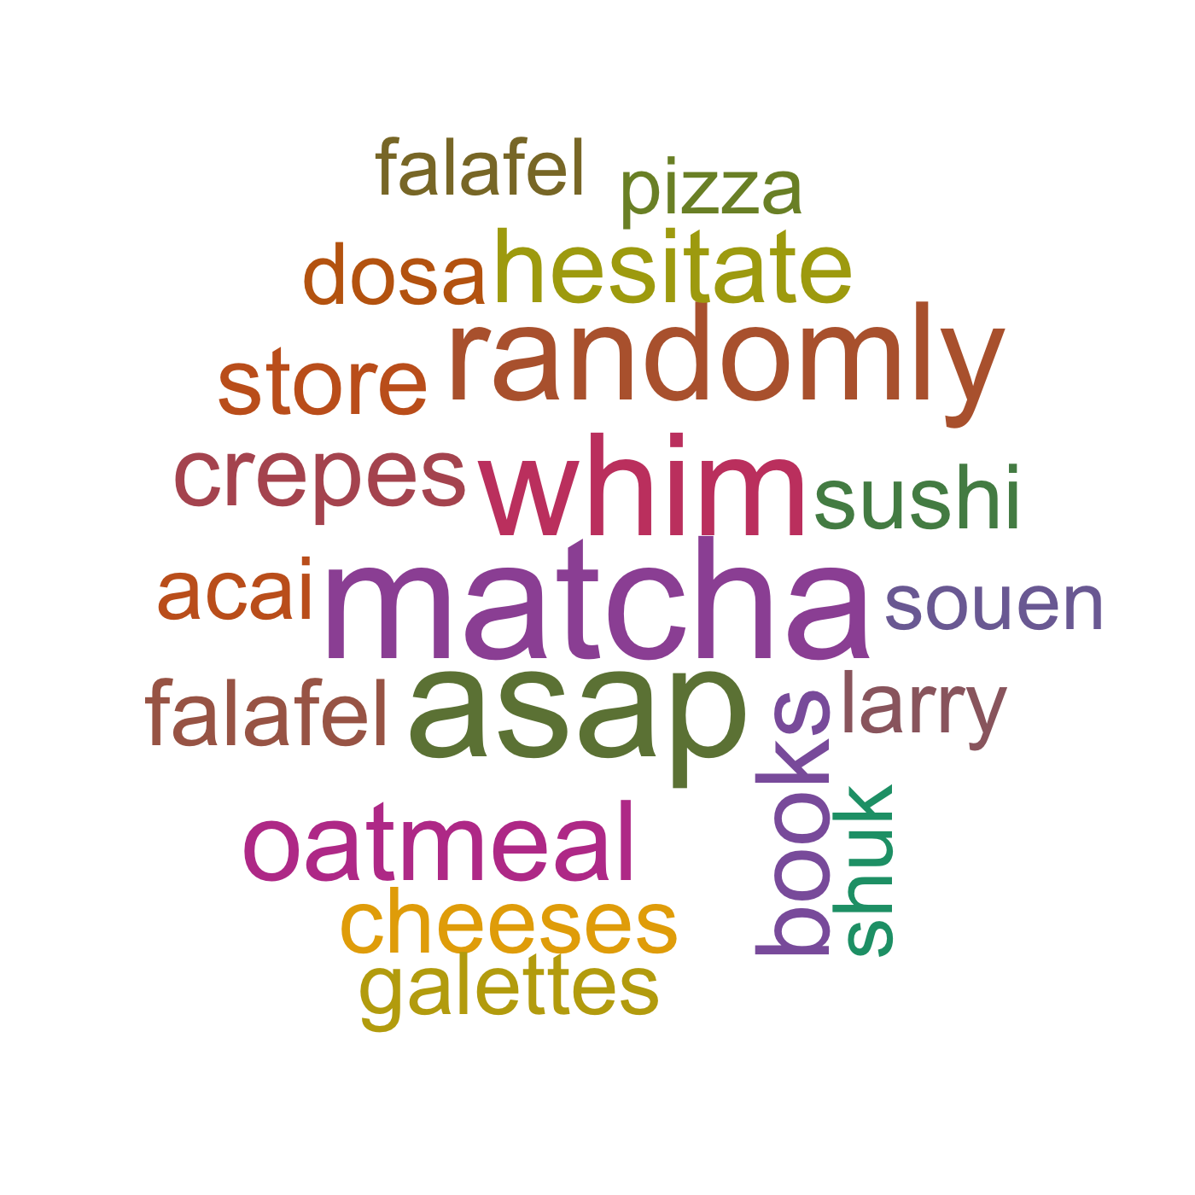
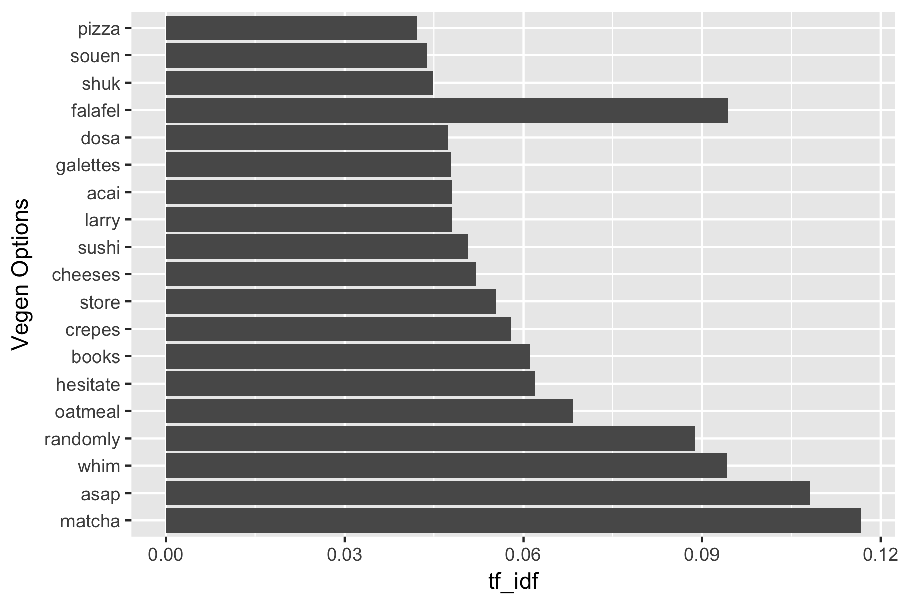
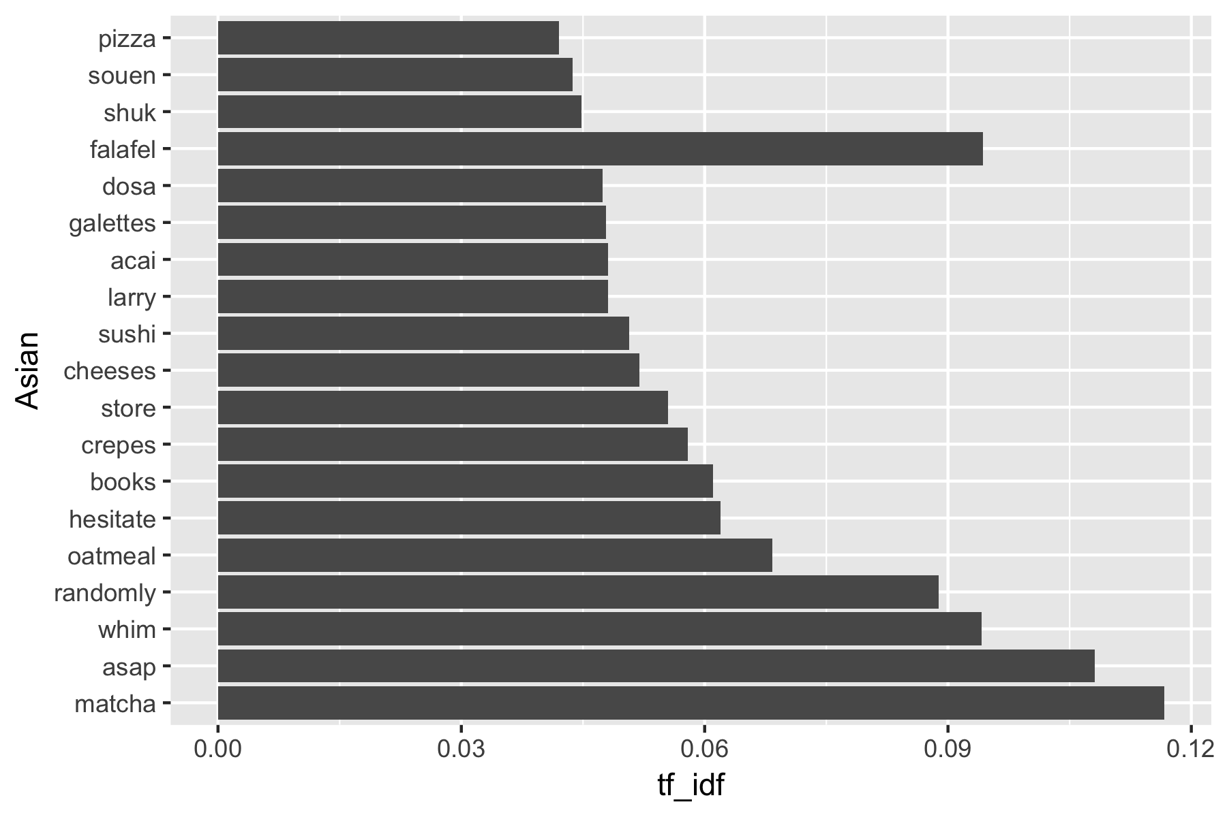
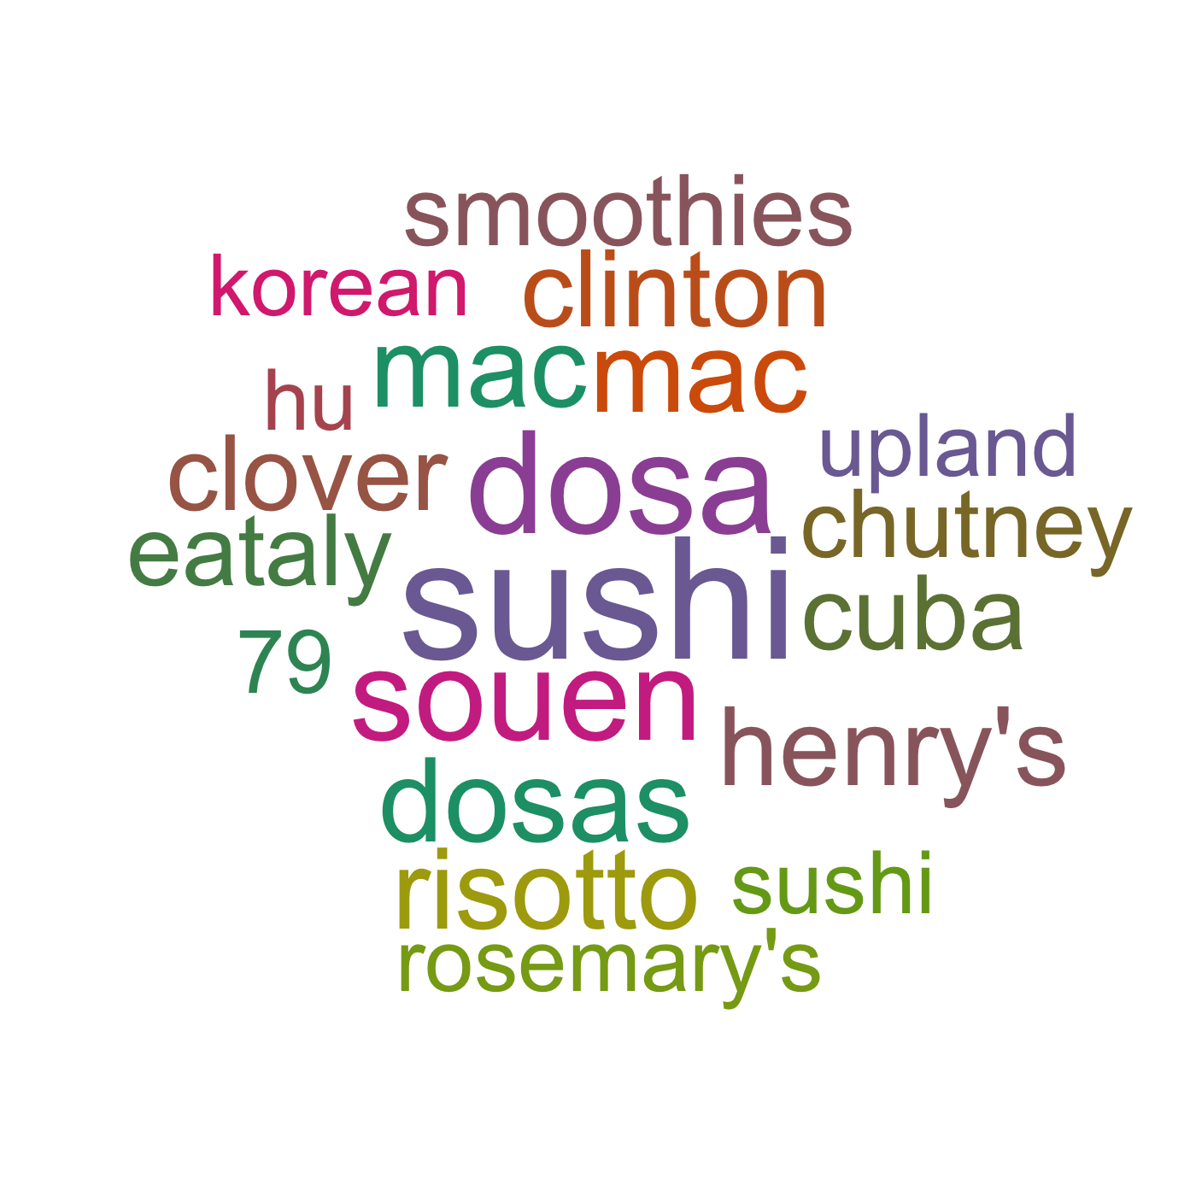
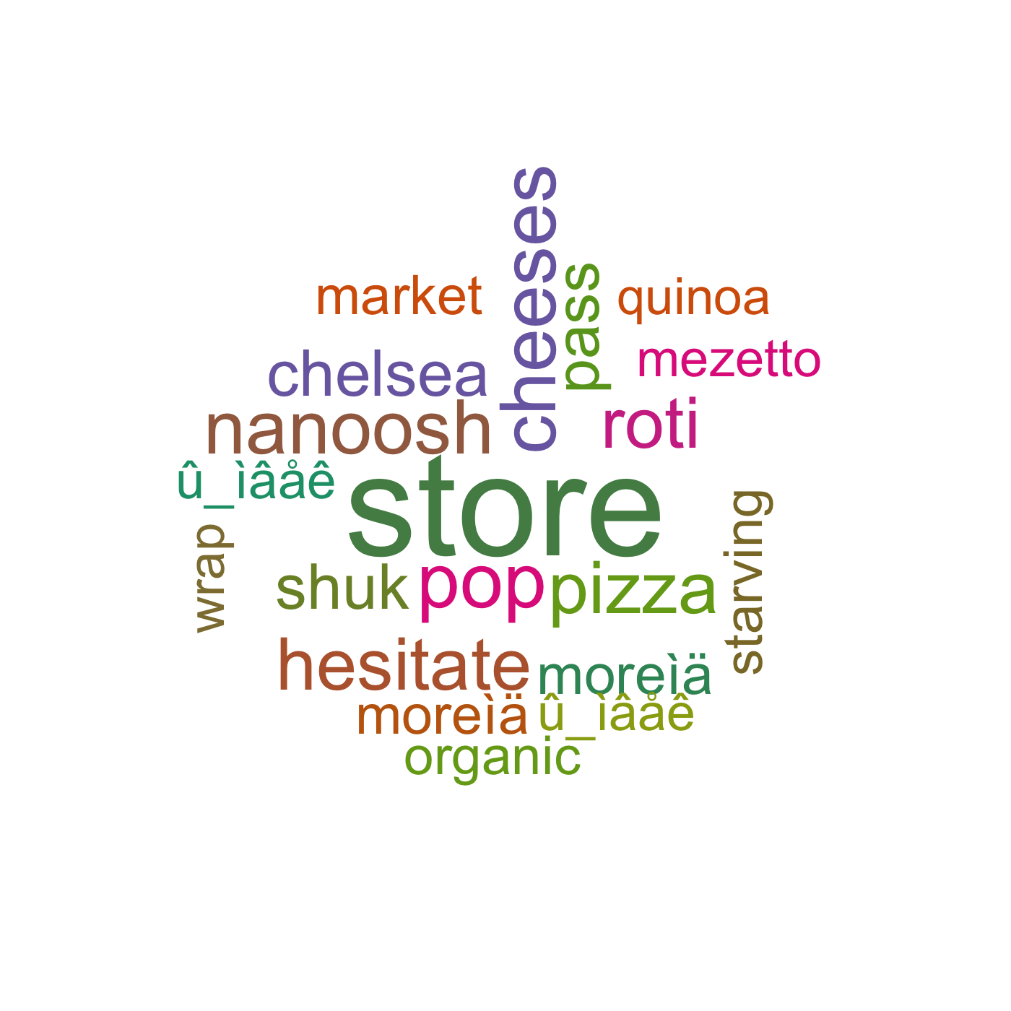
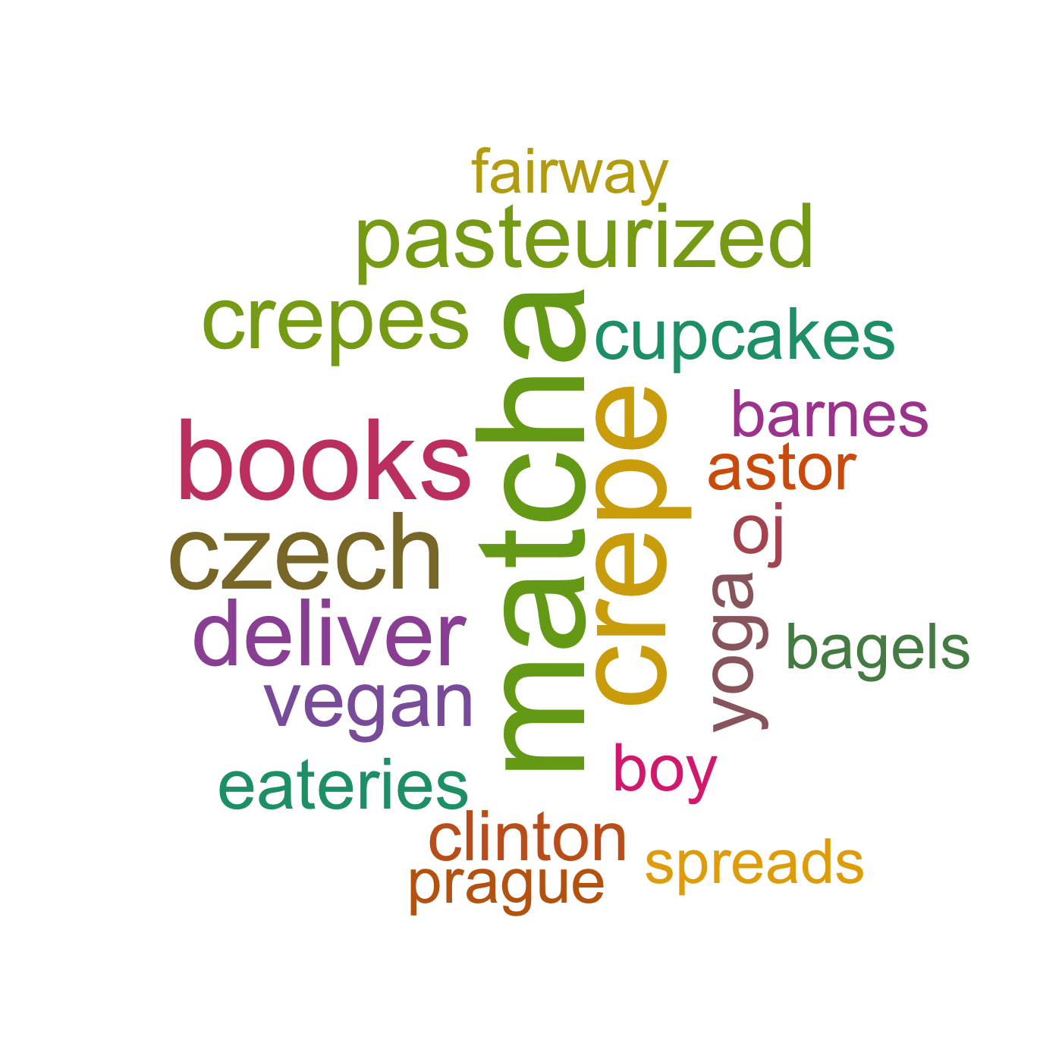
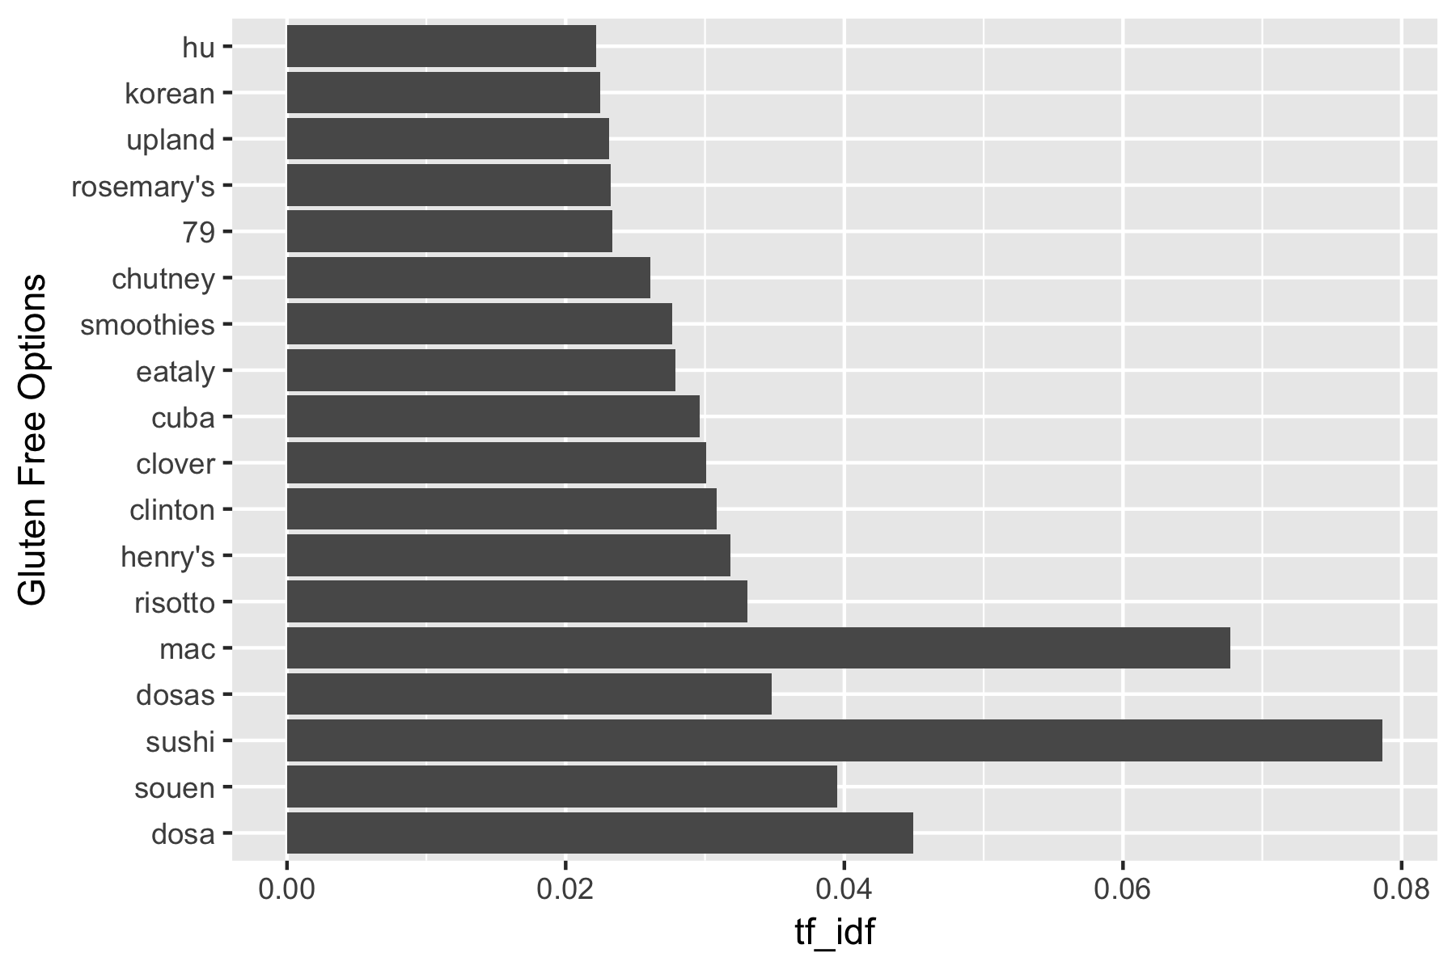

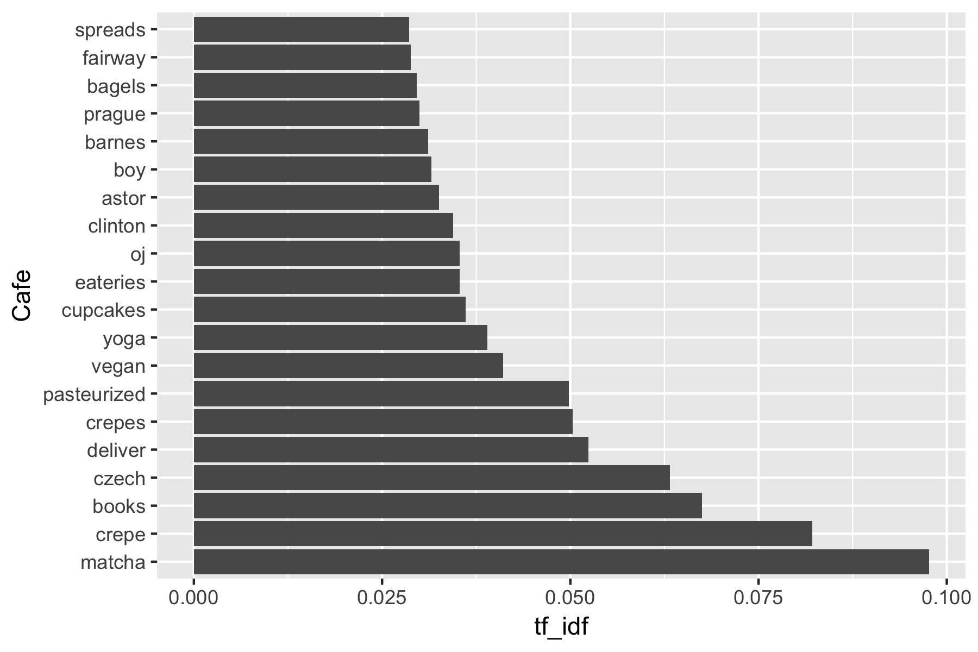
American
Vegan Options
Asian
Gluten Free Option
Mediterranean
Cafe

Slide 8
Doc2Vec

Slide 9
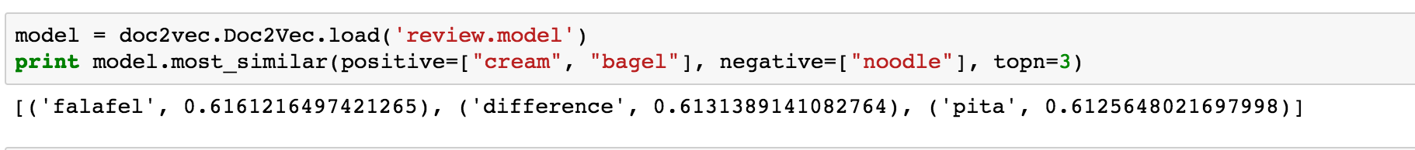
Cosine similarity: a measure of similarity between two non zero vectors of an inner product space that measures the cosine of the angle between them

Slide 10
Thank you!

